Slide 1
Overview of Global Land Data Assimilation (GLDAS) Runoff Data
17 November, 2022
Notes:
National Aeronautics and Space Administration

Slide 2
Learning Objectives
Describe Global Land Data Assimilation System (GLDAS)
Access GLDAS Runoff Data

Slide 3
Rationale: Why use GLDAS for Runoff?
Surface Runoff cannot be measured directly
Stream gauges can measure volume of water passing through a water channel or river and can provide estimate of runoff in the channel but non-infiltrated surface runoff can only be calculated from water balance
Models such as GLDAS provide estimate of runoff along with other surface water components

Slide 4
Outline
Land Data Assimilation System
GLDAS Runoff Data

Slide 5
Land Data Assimilation System (GLDAS)

Slide 6
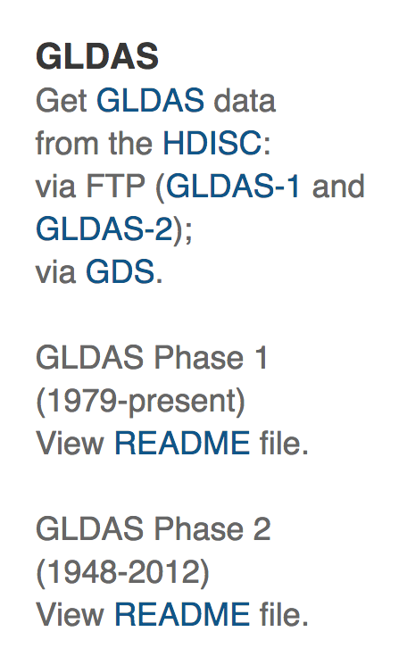
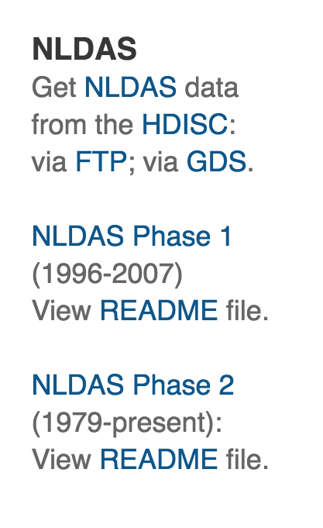
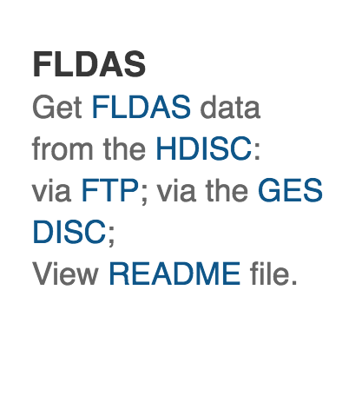
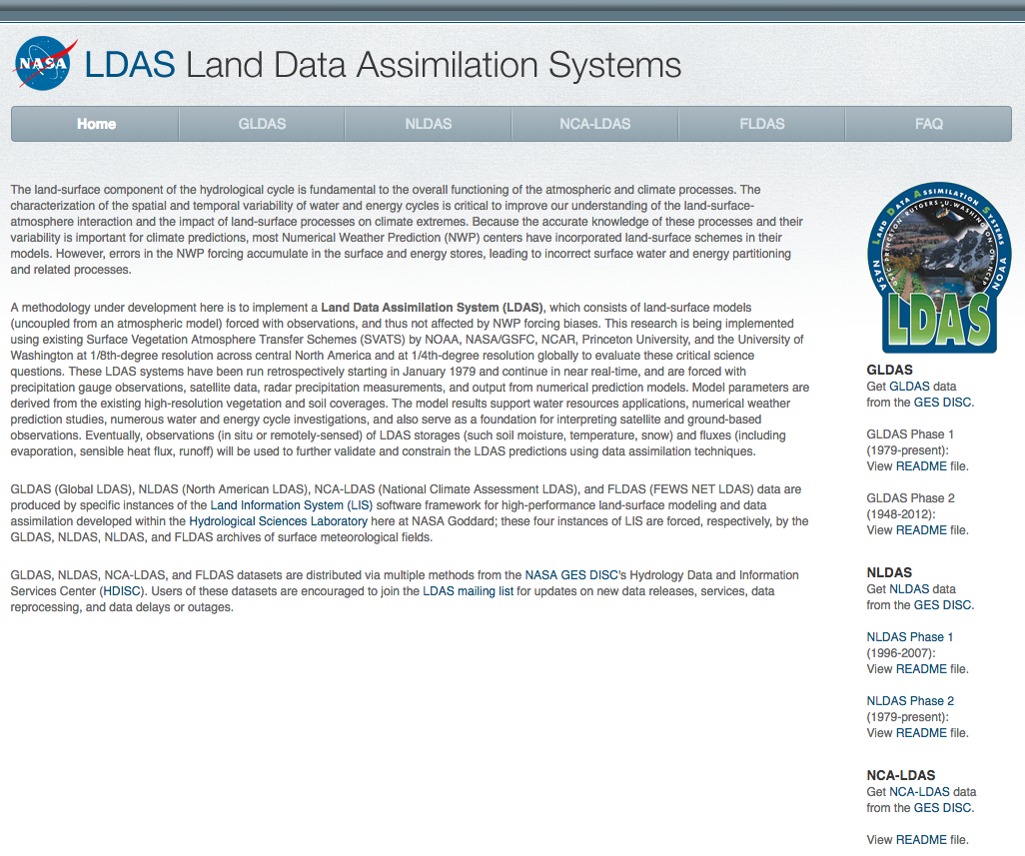
What is the Land Data Assimilation System?
Integrates satellite and ground observations within sophisticated numerical models with water and energy balance
http://ldas.gsfc.nasa.gov

Slide 7
About GLDAS
http://ldas.gsfc.nasa.gov/gldas/
Four land surface model versions: Noah, CLM2, Mosaic, and VIC
Inputs
Rainfall: TRMM and multi-satellite based data
Meteorological Data: global reanalysis and observation-based data from Princeton University
Vegetation Mask, Land/Water Mask, Leaf Area Index: MODIS (GLDAS-2)
Cloud and Snow (for surface radiation): NOAA and DMSP Satellites
Integrated Outputs
Soil Moisture
Evapotranspiration
Surface/Sub-Surface Runoff
Snow Water Equivalent
Notes:
Integrate ground and satellite observations within sophisticated numerical models to produce physically consistent, high resolution fields of land surface states and fluxes
GLDAS and a Version of NLDAS use LIS with Different Sources of Inputs
Meteorological Analysis
Surface Solar Radiation
Precipitation
Soil Texture
Vegetation Classification and Leaf Area Index
Topography
Integrate Output for Water Resources
Soil Moisture
Evapotranspiration
Surface/Sub-surface Runoff
Snow Water Equivalent
Satellite Data used in LDAS: MODIS, TRMM ,GOES

Slide 8
GLDAS Data Access
Model | Spatial/Temporal Resolution | Data Source
GLDAS (NOAH) | 1/4th – 1 degree (global) 3 hour, monthly 1948-2010 | Giovanni http://giovanni.gsfc.nasa.gov/giovanni
NOAH (v2.1) | 2000 - present
VIC | 1979 - present
Original data files are in GRIB format

Slide 9
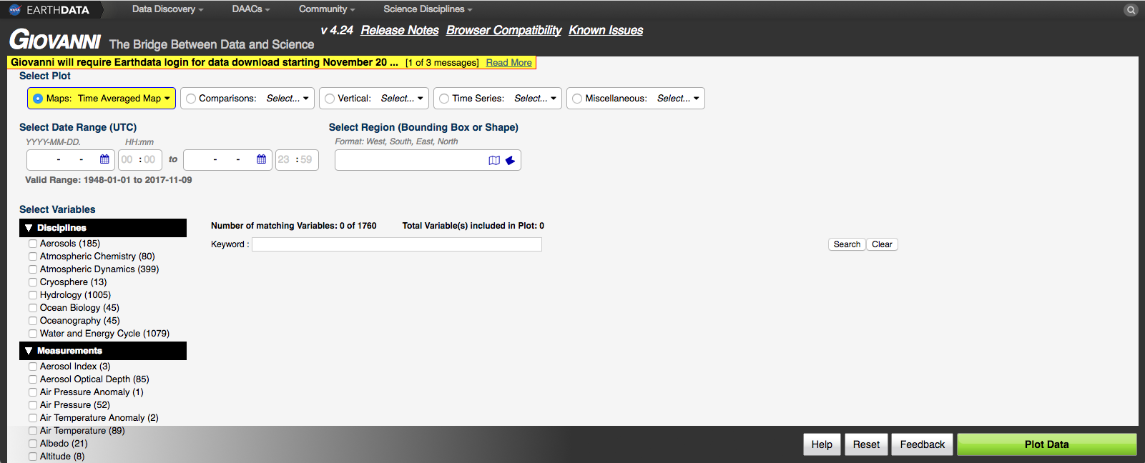
Search, Select, and Download Runoff Data from Giovanni
http://giovanni.gsfc.nasa.gov/giovanni/
Analysis & Plot Options
Temporal & Spatial Search
Map & shapefile selection countries & U.S. states
Search data by keyword
Plot Data

Slide 10
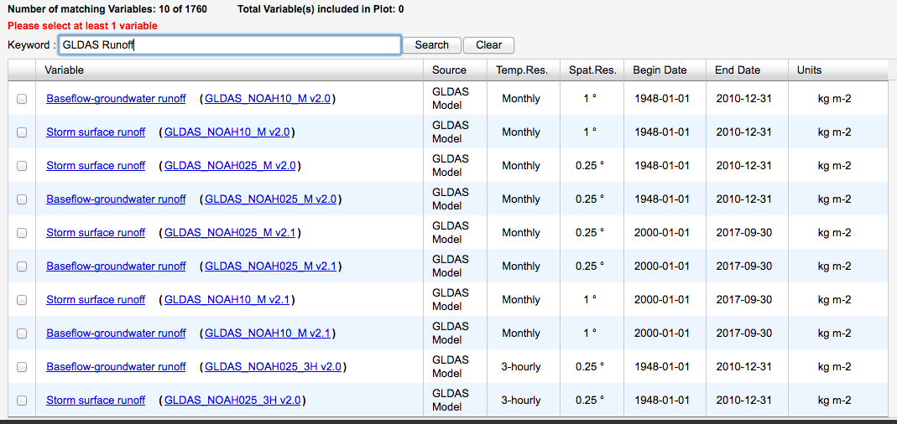
Runoff Data
Available form GLDAS Noah v2.1
Storm surface runoff is available at monthly and hourly time scales, at 0.25° and 1° resolution

Slide 11
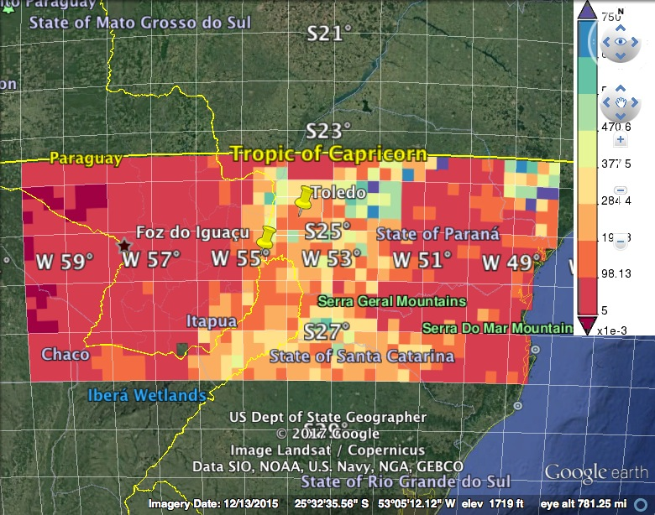
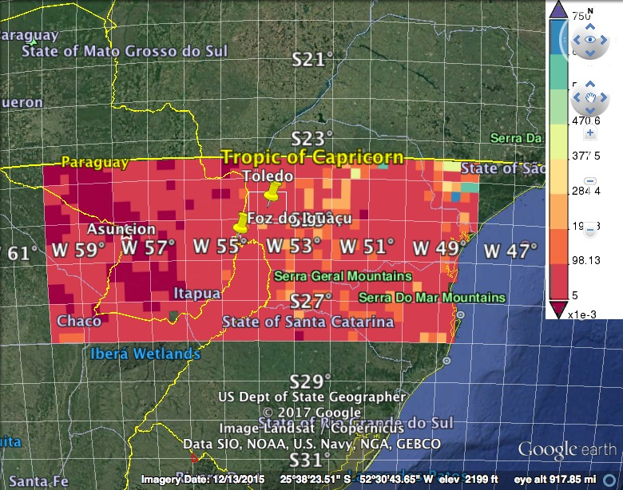
Runoff Over Parana
DJF 2016
DJF 2017

Slide 12
Next: Download Seasonal Runoff Using Giovanni

